Slide 1
FinBro
Financial Patience Calculation solution for banks and their clients
DEVZZERS, HackYeah ‘18

Slide 2
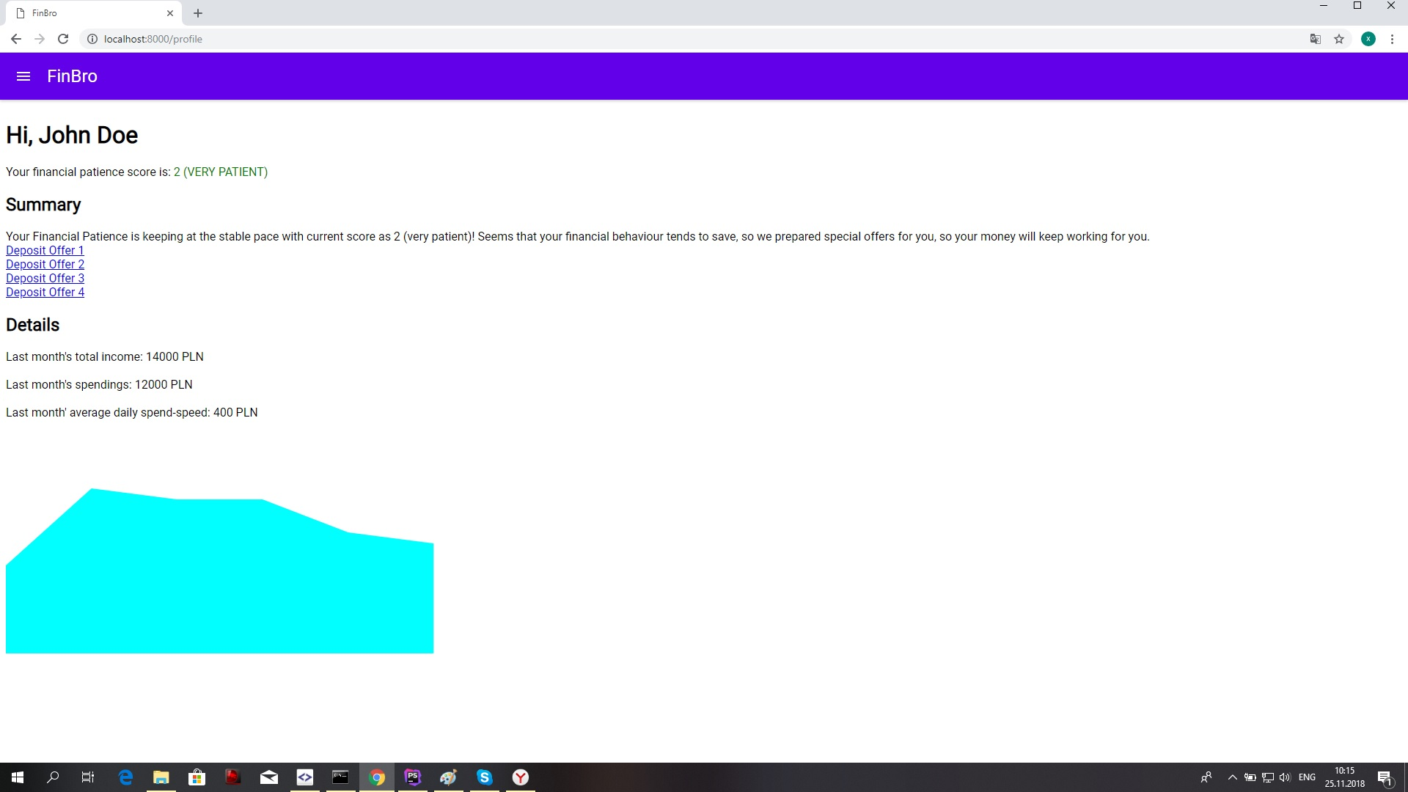
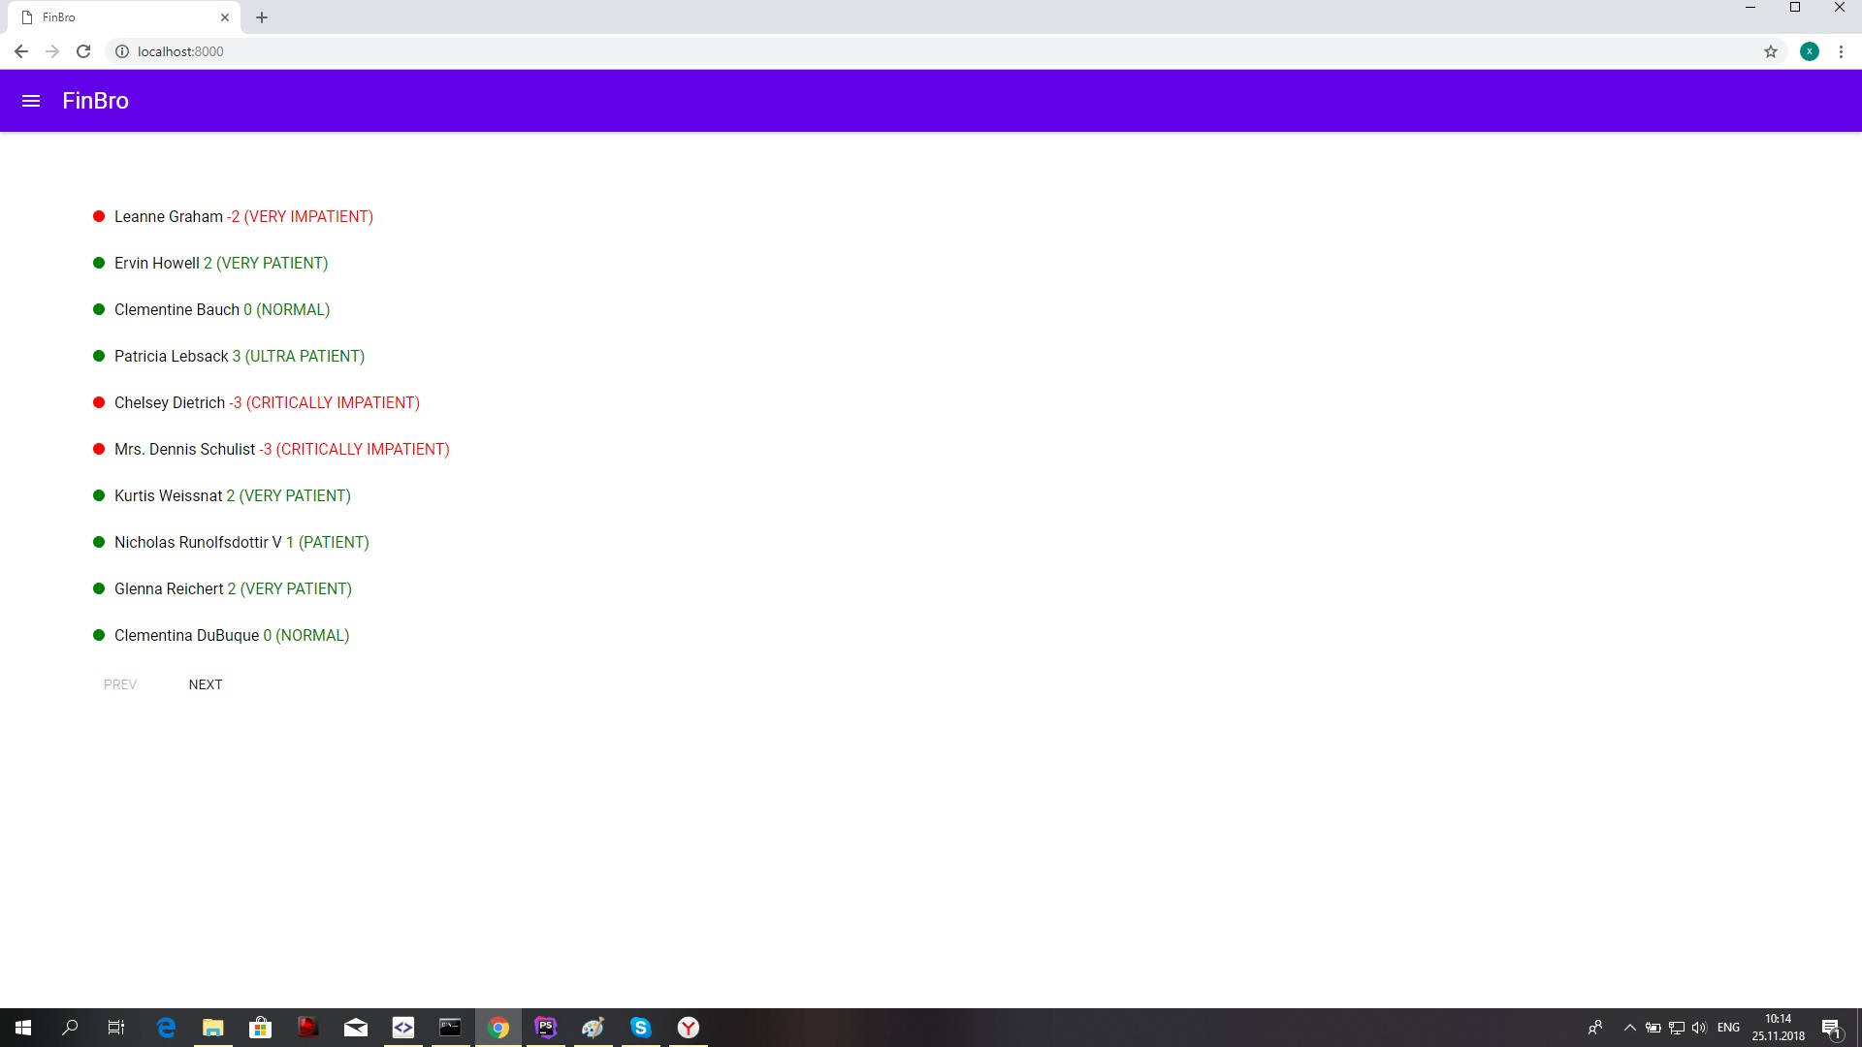
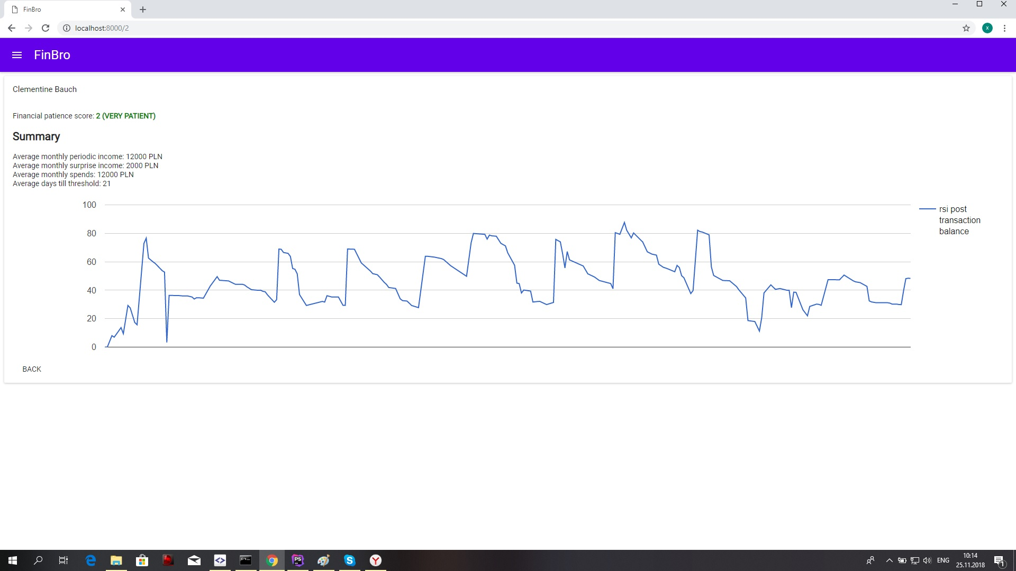
Meet the FinBro App
Live App

Slide 3
Financial Patience
Part of Financial Behavior
Financially impatient people tend to spend more as soon as they receive an income, especially if the income is not regular one (“irregular-income").
More CONSUME than SAVE

Slide 4
Why?
Overall Scoring
Risk management
Business relationship
Customer care
Self-assessment

Slide 5
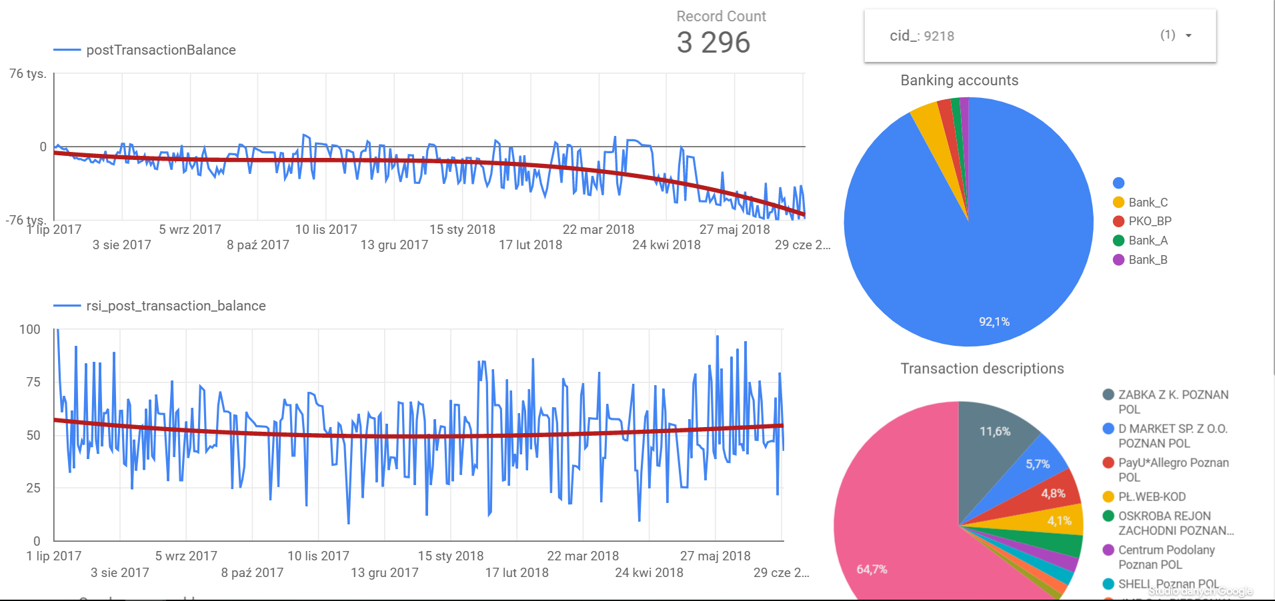
How to calculate?
var Timeframe;
var Thresholds;
Determine client’s regular and irregular incomes
Calculate spending speeds in both cases
Clusterize by thresholds and timeframe
Normalize the data
Map data according to scoring (if needed)
Use in scoring

